Slide 1

Tools to Help Your
Students Transition to College Life
Notes:
Annie

Slide 2

Acceptance & Deposit
Institutional Fit
Orientation
Advisement
Curriculum
Academic Major
Academic Support
Career Services
Notes:
Annie

Slide 3

a seamless support system for our students
Notes:
Annie

Slide 4
GRIFF Center
- strives to support -
Striving for Magis
Pursuing Diversity
Promoting Justice
Promoting Critical Inquiry
Instilling Leadership in Service
The 5 Pillars of Jesuit Education
http://www.usfca.edu/about/jesuit/
Notes:
Annie

Slide 5
New Student Orientation / Griff 101 Experience
Academic and Career Advisement for
New Students, Student-Athletes and Undecided Majors
^{Griff Career Action Plan}
^{A} Comprehensive Internship Program for all Students
Continuous Career Support for Alumni
^{Academic Mentoring Program}
^{Accessibility Support}
^{Veteran Support}
^{Griff Parent Program}
^{Tutoring & Study Center /} ^{Academic Workshops}
^{General Proctor Site}
New Student Orientation / Griff 101
Academic and Career Advisement for
New Students, Student-Athletes and Undecided Majors
^{Griff Career Action Plan}
Continuous Career Support for Alumni
^{A} Comprehensive Internship Program for all Students
^{Academic Mentoring Program}
^{Accessibility Support •} ^{Veteran Support}
^{Griff Parent Program}
^{Tutoring & Study Center /} ^{General Proctor Site}
A variety of Academic Workshops offered throughout the semester
Notes:
Annie

Slide 6
WHO WE ARE
Professionals who are trained in student development; who offer academic assistance;
and provide services tailored
to address the diverse developmental
stages of a student’s academic career
New Student Orientation / Griff 101
Academic and Career Advisement for
New Students, Student-Athletes and Undecided Majors
^{Griff Career Action Plan}
Continuous Career Support for Alumni
^{A} Comprehensive Internship Program for all Students
^{Academic Mentoring Program}
^{Accessibility Support •} ^{Veteran Support}
^{Griff Parent Program}
^{Tutoring & Study Center /} ^{General Proctor Site}
A variety of Academic Workshops offered throughout the semester
Notes:
Annie

Slide 7
HOW WE DELIVER
Student-Centric Approach
Encouraging students to ask for assistance while guiding them to become self-advocates of their academic and professional careers
New Student Orientation / Griff 101
Academic and Career Advisement for
New Students, Student-Athletes and Undecided Majors
^{Griff Career Action Plan}
Continuous Career Support for Alumni
^{A} Comprehensive Internship Program for all Students
^{Academic Mentoring Program}
^{Accessibility Support •} ^{Veteran Support}
^{Griff Parent Program}
^{Tutoring & Study Center /} ^{General Proctor Site}
A variety of Academic Workshops offered throughout the semester
Notes:
Annie

Slide 8
WHY WE DO, WHAT WE DO
Advisement is intentional and focused
on identifying student strengths and
helping students identify/clarify
their personal and
professional interests/goals
New Student Orientation / Griff 101
Academic and Career Advisement for
New Students, Student-Athletes and Undecided Majors
^{Griff Career Action Plan}
Continuous Career Support for Alumni
^{A} Comprehensive Internship Program for all Students
^{Academic Mentoring Program}
^{Accessibility Support •} ^{Veteran Support}
^{Griff Parent Program}
^{Tutoring & Study Center /} ^{General Proctor Site}
A variety of Academic Workshops offered throughout the semester
Notes:
Annie

Slide 9

New Freshman Registration
Once a student deposits with the Admissions Office,
they are given access to the New Student Portal.
The New Student Portal will help keep the student organized and on track as they prepare for the fall semester.
Included in the New Student Portal is the Course Preference Form. Professionals in The GRIFF Center will use this form to help create the student’s fall class schedule.

Slide 10
Course Preference From
The Course Preference Form asks for information about major interests, courses completed in high school, any incoming credit, and general information about interests and goals.
The form asks to rank some top choices of courses for the different core curriculum requirements.

Slide 11
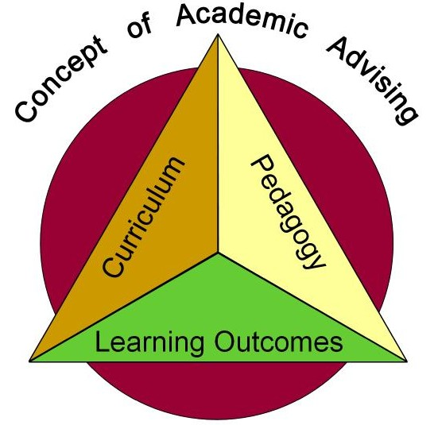
Academic advising, along with teaching, research, and service,
is central to achieving the fundamental goals of higher education.
Comprehensive approach to
student development that includes intellectual, spiritual,
and personal growth.
This academic advisement approach allows students to receive assistance and become responsible for their educational, career, and personal goals.
New Student Orientation / Griff 101
Academic and Career Advisement for
New Students, Student-Athletes and Undecided Majors
^{Griff Career Action Plan}
Continuous Career Support for Alumni
^{A} Comprehensive Internship Program for all Students
^{Academic Mentoring Program}
^{Accessibility Support •} ^{Veteran Support}
^{Griff Parent Program}
^{Tutoring & Study Center /} ^{General Proctor Site}
A variety of Academic Workshops offered throughout the semester
Notes:
Annie

Slide 12
Core Curriculum
Foundation Courses — emphasize critical reading, writing, and thinking skills
FYS 101 Exploration of Academic Writing
RST 101 Intro to Religious Studies
II. Fields of Knowledge - students complete one course in each field
from a range of designated courses.
Field 1 Religious Studies & Theology
Field 2 Philosophy
Field 3 Arts & Literature
Field 4 History
III. Attributes - Students select one course for each requirement.
The Cross-disciplinary Knowledge and Skills Attributes are:
Justice • Ethics • Diversity • Global Awareness • Writing Intensive • Oral Communication
IV. Core Capstone - During senior year, all students complete a Capstone course that enables them to reflect upon the goals of the core curriculum and to develop leadership and a sense of the value of public service.
ENG 101 Writing About Literature
PHI 101 Intro to Philosophy
Field 5 Social Sciences
Field 6 Natural Sciences
Field 7 Mathematical Sciences

Slide 13
Many Opportunities
Over 70 majors, minors,
pre-professional & special programs
in the following divisions:
College of Arts & Sciences
Richard J. Wehle School of Business
School of Education & Human Services
New Student Orientation / Griff 101
Academic and Career Advisement for
New Students, Student-Athletes and Undecided Majors
^{Griff Career Action Plan}
Continuous Career Support for Alumni
^{A} Comprehensive Internship Program for all Students
^{Academic Mentoring Program}
^{Accessibility Support •} ^{Veteran Support}
^{Griff Parent Program}
^{Tutoring & Study Center /} ^{General Proctor Site}
A variety of Academic Workshops offered throughout the semester
Notes:
Annie

Slide 14
Academic Support
The Tutoring Center provides opportunities to achieve academic success through peer and adjunct professor tutors assisting in a variety of academic disciplines.
Study Center offers an opportunity to focus on their academic work in a quiet, distraction-free environment.
Academic Mentors meet regularly to assist with time management, study skills, academic strategies and much more — to help students achieve success.
New Student Orientation / Griff 101
Academic and Career Advisement for
New Students, Student-Athletes and Undecided Majors
^{Griff Career Action Plan}
Continuous Career Support for Alumni
^{A} Comprehensive Internship Program for all Students
^{Academic Mentoring Program}
^{Accessibility Support •} ^{Veteran Support}
^{Griff Parent Program}
^{Tutoring & Study Center /} ^{General Proctor Site}
A variety of Academic Workshops offered throughout the semester
Notes:
Annie

Slide 15
Academic Support
Accessibility Support is committed to creating equal access for all students with disabilities. It helps meet the needs of individuals registered and documented through the office, whether the disability is permanent or temporary.
General Proctor administers academic accommodations
to registered students with disabilities as well as is a service to students without disabilities.
Veteran Support has dedicated resources and space to providing an environment that is supportive and friendly,
who are veterans feel comfortable seeking assistance with both academic and non-academic issues.
New Student Orientation / Griff 101
Academic and Career Advisement for
New Students, Student-Athletes and Undecided Majors
^{Griff Career Action Plan}
Continuous Career Support for Alumni
^{A} Comprehensive Internship Program for all Students
^{Academic Mentoring Program}
^{Accessibility Support •} ^{Veteran Support}
^{Griff Parent Program}
^{Tutoring & Study Center /} ^{General Proctor Site}
A variety of Academic Workshops offered throughout the semester
Notes:
Annie

Slide 16

New Student Orientation / Griff 101
Academic and Career Advisement for
New Students, Student-Athletes and Undecided Majors
^{Griff Career Action Plan}
Continuous Career Support for Alumni
^{A} Comprehensive Internship Program for all Students
^{Academic Mentoring Program}
^{Accessibility Support •} ^{Veteran Support}
^{Griff Parent Program}
^{Tutoring & Study Center /} ^{General Proctor Site}
A variety of Academic Workshops offered throughout the semester
Steps to determining the best major…
Career and life planning is a process of discovery that focuses on
strengths and ways to apply them beyond the classroom
Notes:
Annie

Slide 17

Career Services include:
Career Resources
Career Coaching
Professional Development Services
Job and Internship Postings
Career Services Delivery
Assessment/Evaluation
Career
Services
Services include career resources and coaching, professional development services, job and internship posting, and assessment/eatf the components
Career Resources
Career Coaching
Professional Development Services
Job and Internship Postings
Career Services Delivery
Assessment/Evaluation
Notes:
Annie

Slide 18

Top 10 Skills
Employers Want to See…
Leadership
Ability to work in a team
Written communication skills
Problem-solving skills
Strong work ethic
Analytical/quantitative skills
Technical skills
Verbal communication skills
Initiative
Computer skills
It’s a given that a good grade point average (GPA) is very important to potential employers.
Employers considering
new college graduates
for job openings are
looking for leaders who can work as part of team, communicate effectively, and solve problems.
Notes:
Annie

Slide 19
Notes:
Annie

Slide 20

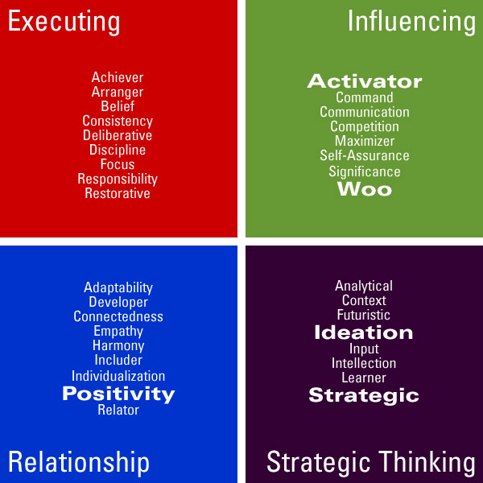
34 Themes
Notes:
Eileen

Slide 21

^{Exclusive portal,} where Canisius students and alumni may access:
^{– job opportunities}
^{– internships}
^{– career events}
^{– workshops}
– additional Griff Center resources
Single sign-on option for students
Upload resumes, cover letters, and documents
^{Internship/Job Placement}
^{Data Collection & Assessment}
Notes:
Allison

Slide 22
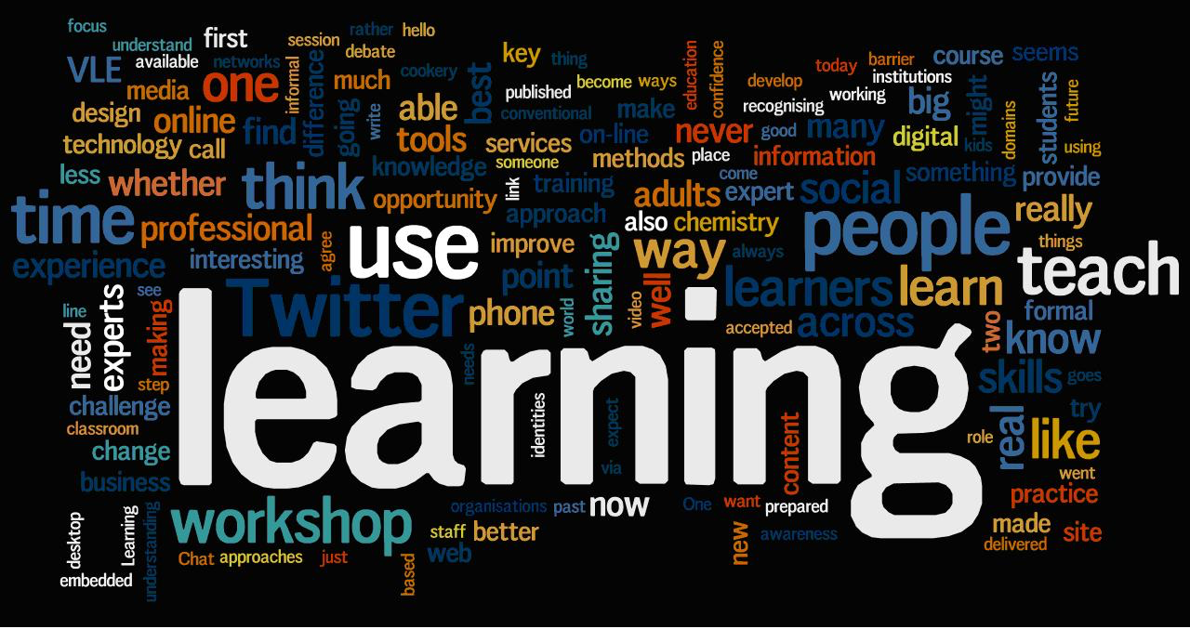
The goal is to provide students with the academic support and assistance they need
to become successful lifelong learners

Slide 23
— For More Information —
Anne Marie Dobies
Assistant Vice President
Griff Center for Academic Engagement
Canisius College
2001 Main Street • Buffalo, NY 14208
716.888.3749
dobies@canisius.edu

